Slide 1
Generalized Quantum
Arthur-Merlin Games
Hirotada Kobayashi (NII)
Francois Le Gall (U. Tokyo)
Harumichi Nishimura (Nagoya U.)
CCC’2015@Portland
June 19, 2015

Slide 2
Outline
Our focus: single-prover constant-turn quantum interactive proofs
Background
  Interactive proofs & Arthur-Merlin games
  Quantum IPs
  QAM: Quantum analogue of Arthur-Merlin proof systems where the verifier is classical except the last operation
Our models: generalized quantum AMs
  qq-QAM: Fully-quantum analogue of Arthur-Merlin proof systems
Our results
  quantum analogue of Babai’s collapse theorem

Slide 3
Background

Slide 4
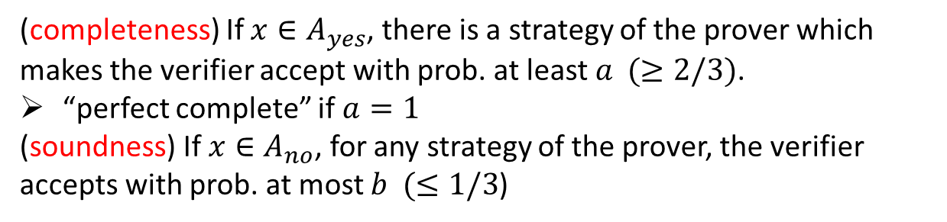
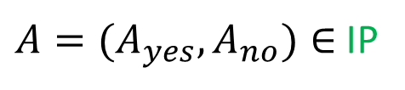
Interactive Proof Systems
Prover
unbounded powerful
Verifier
poly.-time randomized algorithm
Interactive communication
$A=(A_{yes},A_{no})∈$ IP
There is a poly.-time interactive protocol such that: for any $x$,
(completeness) If $x∈A_{yes}$, there is a strategy of the prover which makes the verifier accept with prob. at least $a (≥2/3)$.
“perfect complete” if $a=1$
(soundness) If ${x∈A}_{no}$, for any strategy of the prover, the verifier accepts with prob. at most $b (≤1/3$)

Slide 5
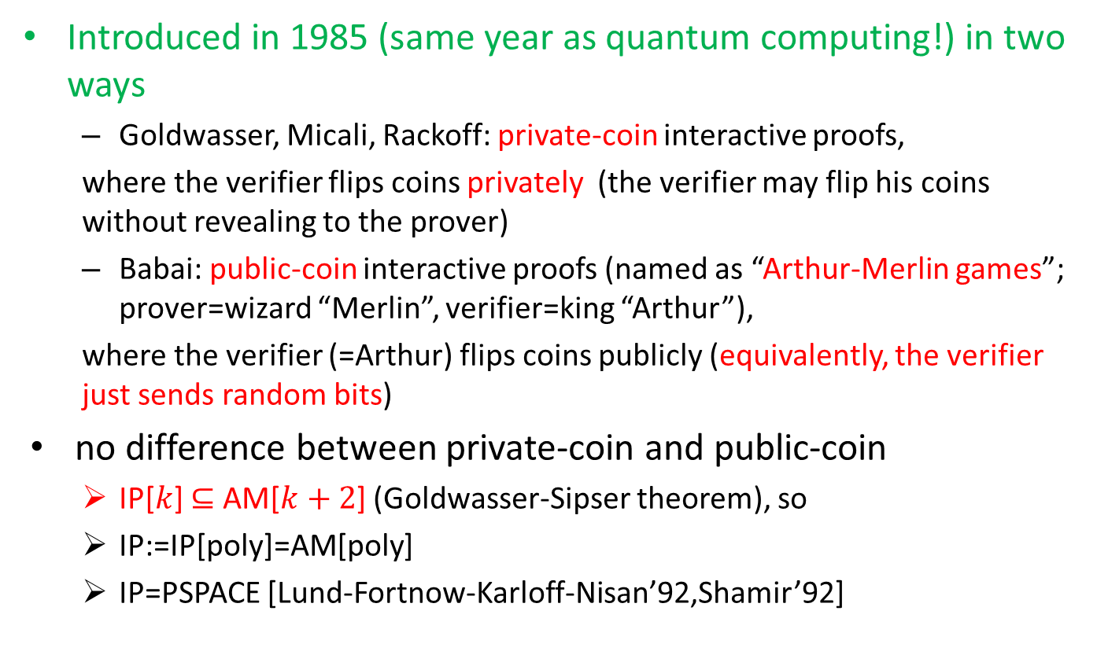
Interactive Proof Systems
Introduced in 1985 (same year as quantum computing!) in two ways
  Goldwasser, Micali, Rackoff: private-coin interactive proofs,
  where the verifier flips coins privately (the verifier may flip his coins without revealing to the prover)
  Babai: public-coin interactive proofs (named as “Arthur-Merlin games”; prover=wizard “Merlin”, verifier=king “Arthur”),
  where the verifier (=Arthur) flips coins publicly (equivalently, the verifier just sends random bits)
no difference between private-coin and public-coin
  IP[$k$] $⊆$ AM[$k+2$] (Goldwasser-Sipser theorem), so
  IP:=IP[poly]=AM[poly]
  IP=PSPACE [Lund-Fortnow-Karloff-Nisan’92,Shamir’92]

Slide 6

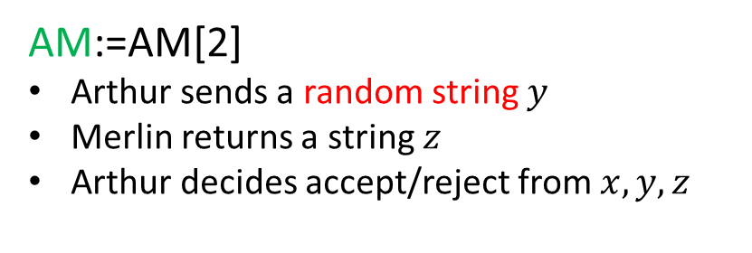


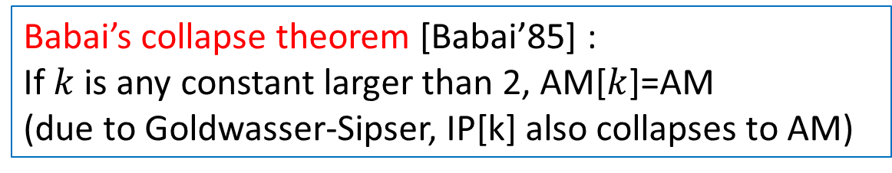
AM
AM:=AM[2]
Arthur sends a random string $y$
Merlin returns a string $z$
Arthur decides accept/reject from $x, y, z$
$$y$$
instance $x$
Prover (Merlin)
$$z$$
Verifier (Arthur)
Babai’s collapse theorem [Babai’85] :
If $k$ is any constant larger than 2, AM[$k$]=AM
(due to Goldwasser-Sipser, IP[k] also collapses to AM)
AM is one of fundamental complexity classes
AM=AM₁
SZK is in AM & coAM [Fortnow’87,Aiello-Hastad’91]
Notes:
magic stick; crown

Slide 7
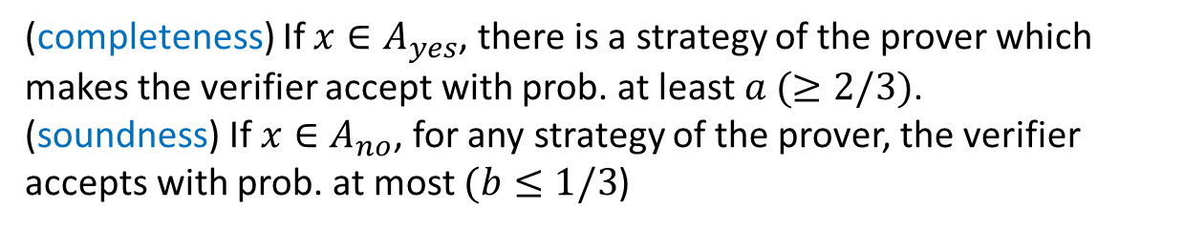
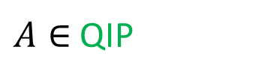
Quantum Interactive Proof Systems
[Watrous’99,Kitaev-Watrous’00]
Prover
unboundedly powerful quantum operation
Verifier
poly.-time quantum algorithm
quantum communication
$A∈$ QIP
There is a poly.-time interactive protocol such that: for any $x$,
(completeness) If $x∈A_{yes}$, there is a strategy of the prover which makes the verifier accept with prob. at least $a (≥2/3)$.
(soundness) If ${x∈A}_{no}$, for any strategy of the prover, the verifier accepts with prob. at most $(b≤1/3$)

Slide 8
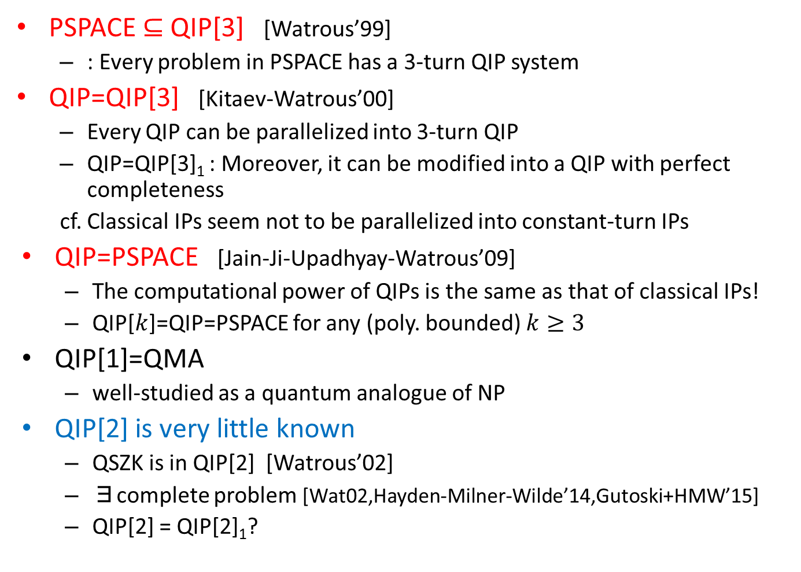
Number of Turns of QIPs
PSPACE $⊆$ QIP[3] [Watrous’99]
  : Every problem in PSPACE has a 3-turn QIP system
QIP=QIP[3] [Kitaev-Watrous’00]
  Every QIP can be parallelized into 3-turn QIP
  QIP=QIP[3]₁ : Moreover, it can be modified into a QIP with perfect completeness
  cf. Classical IPs seem not to be parallelized into constant-turn IPs
QIP=PSPACE [Jain-Ji-Upadhyay-Watrous’09]
  The computational power of QIPs is the same as that of classical IPs!
  QIP[$k$]=QIP=PSPACE for any (poly. bounded) $k≥3$
QIP[1]=QMA
  well-studied as a quantum analogue of NP
QIP[2] is very little known
  QSZK is in QIP[2] [Watrous’02]
  ∃complete problem [Wat02,Hayden-Milner-Wilde’14,Gutoski+HMW’15]
  QIP[2] = QIP[2]₁?

Slide 9

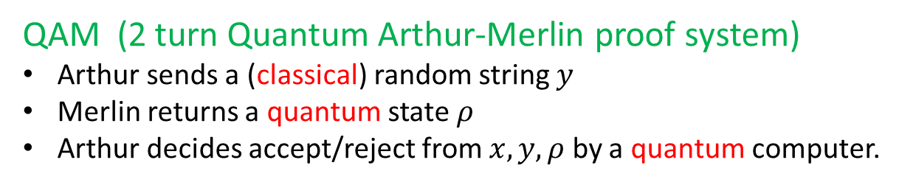


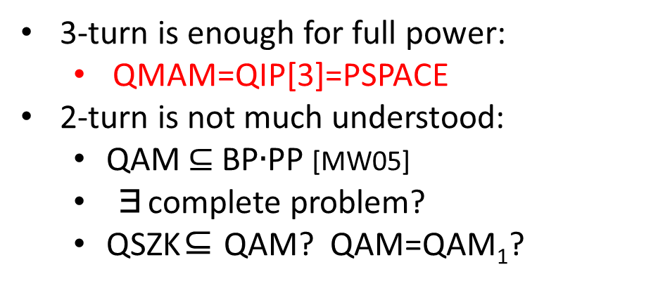
QAM: Quantum Analogue of AM
[Marriott-Watrous’05]
QAM (2 turn Quantum Arthur-Merlin proof system)
Arthur sends a (classical) random string $y$
Merlin returns a quantum state $ρ$
Arthur decides accept/reject from $x, y, ρ$ by a quantum computer.
$$y$$
instance $x$
Prover (Merlin)
$$ρ$$
Verifier (Arthur)
Known Results
3-turn is enough for full power:
  QMAM=QIP[3]=PSPACE
2-turn is not much understood:
  QAM $⊆$BP$∙$PP [MW05]
  ∃complete problem?
  QSZK⊆ QAM? QAM=QAM₁?
QMAM
Notes:
not fully quantum

Slide 10
Our Models & Results

Slide 11
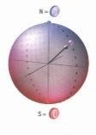
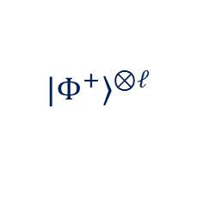


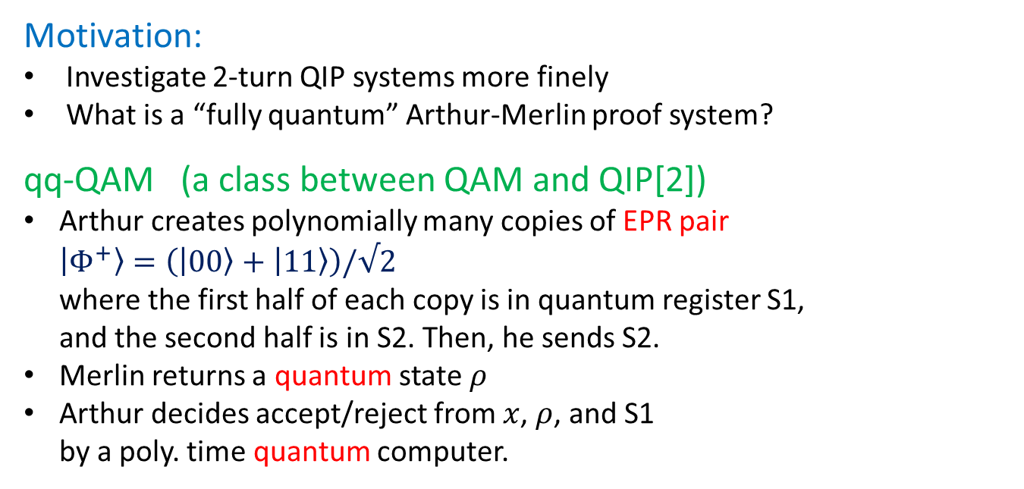



New Model: “Fully-Quantum” Analogue of AM
Motivation:
Investigate 2-turn QIP systems more finely
What is a “fully quantum” Arthur-Merlin proof system?
qq-QAM (a class between QAM and QIP[2])
Arthur creates polynomially many copies of EPR pair $\left|\left.Φ^{+}\right\rangle =(|00〉+ | 11〉\right)/√2$
where the first half of each copy is in quantum register S1,
and the second half is in S2. Then, he sends S2.
Merlin returns a quantum state $ρ$
Arthur decides accept/reject from $x$, $ρ$, and S1
by a poly. time quantum computer.
S2
S1
$$|Φ^{+}〉$$
$$|Φ^{+}〉$$
・・・
$$|Φ^{+}〉$$
S1
S2
$${|\left.Φ^{+}\right\rangle }^{⊗ℓ}$$
instance $x$
Prover (Merlin)
$$ρ$$
Verifier (Arthur)

Slide 12




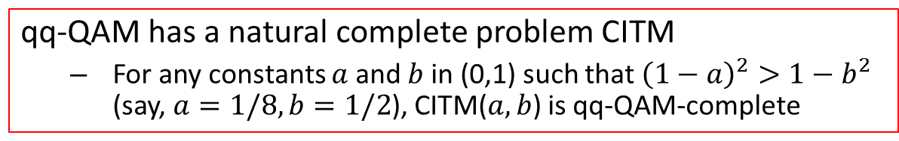





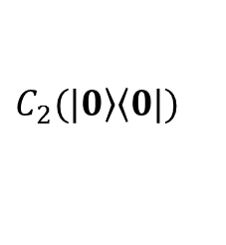

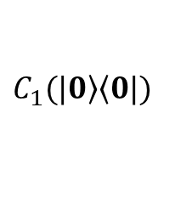










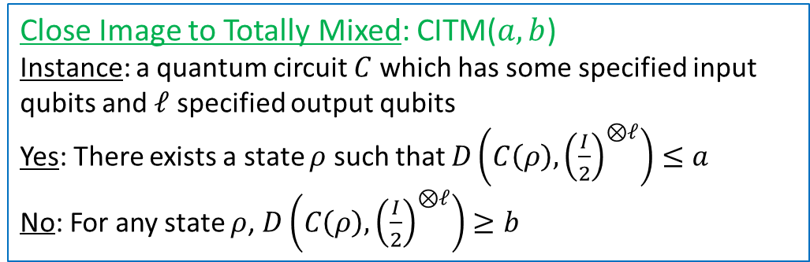




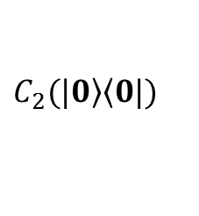
Our Results (Part I)
qq-QAM has a natural complete problem CITM
  For any constants $a$ and $b$ in (0,1) such that ${\left(1−a\right)}^{2}>1−b^{2}$ (say, $a=1/8, b=1/2$), CITM($a,b$) is qq-QAM-complete
Close Image to Totally Mixed: CITM($a,b$)
Instance: a quantum circuit $C$ which has some specified input qubits and $ℓ$ specified output qubits
Yes: There exists a state $ρ$ such that $D\left(C\left(ρ\right),{\left(\frac{I}{2}\right)}^{⊗ℓ}\right)≤a$
No: For any state $ρ$, $D\left(C\left(ρ\right),{\left(\frac{I}{2}\right)}^{⊗ℓ}\right)≥b$
$$∃ρ$$
$$C$$
$$C(ρ)$$
$$≈$$
?
the totally mixed state $\hat{I}$
Image vs. Identity
QIP-complete [Ros-Wat05]
$$∃ρ$$
$$C_{1}(ρ)$$
QIP[2]-complete [Wat02]
$$∃ρ$$
$$C_{1}(ρ)$$
$$C_{1}$$
$$C_{1}$$
$$≈$$
?
$$≈$$
?
$$∃σ$$
$$C_{2}$$
$$C_{2}(σ)$$
$$C_{2}$$
$$C_{2}(|\left.0\right\rangle \left\langle 0|\right.)$$
Image vs. Image
Image vs. State
QSZK-complete [Wat02]
$$C_{1}(|\left.0\right\rangle \left\langle 0|\right.)$$
NIQSZK-complete [Kob03]
$$C(|0〉〈0|)$$
$$C_{1}$$
$$C$$
$$≈$$
?
$$≈$$
?
$$C_{2}$$
$$C_{2}(|\left.0\right\rangle \left\langle 0|\right.)$$
$$\hat{I}$$
State vs. State
State vs. Identity

Slide 13
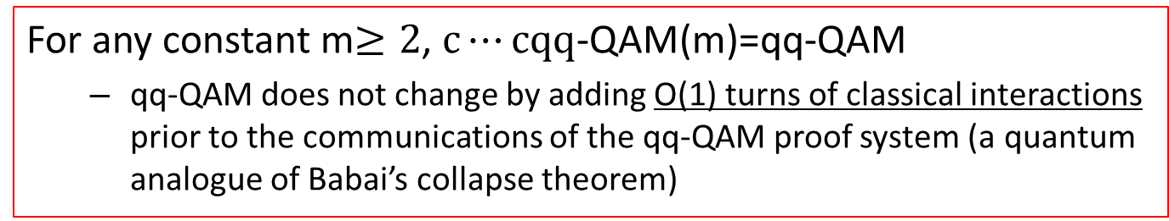
Our Results (Part II)
  For any constant m$≥2$, $c⋯cqq$-QAM(m)=qq-QAM
  qq-QAM does not change by adding O(1) turns of classical interactions prior to the communications of the qq-QAM proof system (a quantum analogue of Babai’s collapse theorem)
(verifier’s classical message)
ccqq-QAM:=ccqq-QAM(4)
verifier sends the outcomes of flipping a fair coin polynomially many times
(verifier’s quantum message)
verifier sends the 1st halves of polynomially many EPR pairs
cccqq-QAM:=ccqq-QAM(5)
(prover’s classical message)
prover sends a classical message
(prover’s quantum message)
prover sends a quantum message

Slide 14
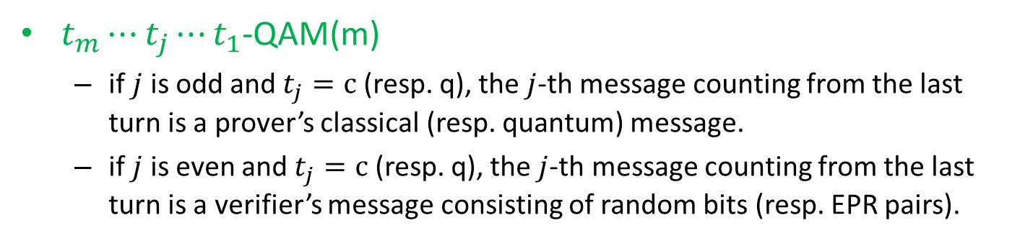
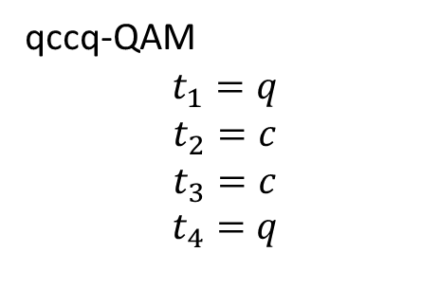
More general collapse theorem
$t_{m}⋯t_{j}⋯t_{1}$-QAM(m)
  if $j$ is odd and $t_{j}=c$ (resp. q), the $j$-th message counting from the last turn is a prover’s classical (resp. quantum) message.
  if $j$ is even and $t_{j}=c$ (resp. q), the $j$-th message counting from the last turn is a verifier’s message consisting of random bits (resp. EPR pairs).
(verifier’s classical message)
verifier sends the outcomes of flipping a fair coin polynomially many times
(verifier’s quantum message)
verifier sends the 1st halves of polynomially many EPR pairs
qccq-QAM
$$t_{1}=q$$
$$t_{2}=c$$
$$t_{3}=c$$
$$t_{4}=q$$
(prover’s classical message)
prover sends a classical message
(prover’s quantum message)
prover sends a quantum message

Slide 15
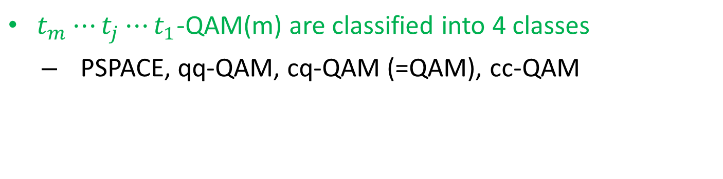
More general collapse theorem
$t_{m}⋯t_{j}⋯t_{1}$-QAM(m) are classified into 4 classes
  PSPACE, qq-QAM, cq-QAM (=QAM), cc-QAM
PSPACE (= qcq-QAM =QMAM)
qq-QAM
cq-QAM
cc-QAM

Slide 16
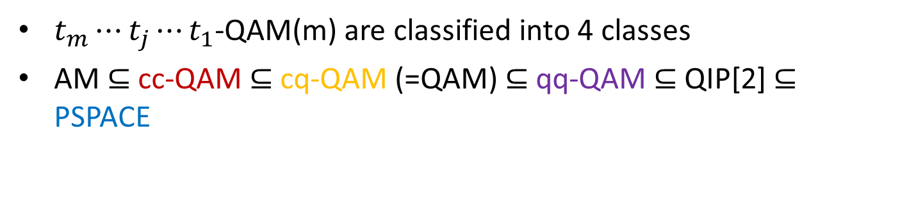
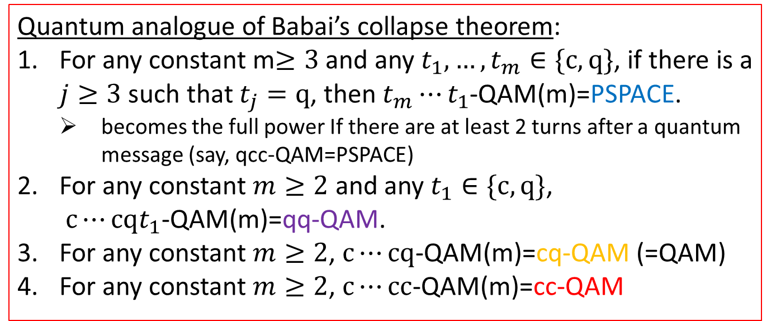
More general collapse theorem
$t_{m}⋯t_{j}⋯t_{1}$-QAM(m) are classified into 4 classes
AM $⊆$ cc-QAM $⊆$cq-QAM (=QAM) $⊆$qq-QAM $⊆$QIP[2] $⊆$ PSPACE
Quantum analogue of Babai’s collapse theorem:
For any constant m$≥3$ and any $t_{1},…,t_{m}∈\{c,q\}$, if there is a $j≥3$ such that $t_{j}=q$, then $t_{m}⋯t_{1}$-QAM(m)=PSPACE.
  becomes the full power If there are at least 2 turns after a quantum message (say, qcc-QAM=PSPACE)
For any constant $m≥2$ and any $t_{1}∈\{c,q\}$, $c⋯cqt_{1}$-QAM(m)=qq-QAM.
For any constant $m≥2$, $c⋯cq$-QAM(m)=cq-QAM (=QAM)
For any constant $m≥2$, $c⋯cc$-QAM(m)=cc-QAM

Slide 17
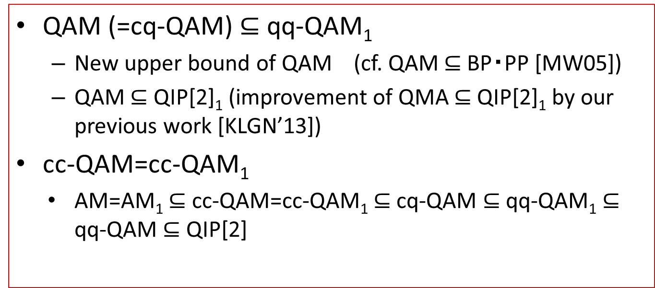
Our Results (Part III)
  QAM (=cq-QAM)$⊆$ qq-QAM₁
  New upper bound of QAM (cf. QAM $⊆$BP・PP [MW05])
  QAM $⊆$ QIP[2]₁ (improvement of QMA $⊆$ QIP[2]₁ by our previous work [KLGN’13])
cc-QAM=cc-QAM₁
    AM=AM₁ $⊆$ cc-QAM=cc-QAM₁ $⊆$ cq-QAM $⊆$ qq-QAM₁ $⊆$ qq-QAM $⊆$ QIP[2]

Slide 18
Proof Ideas (2nd Result)

Slide 19
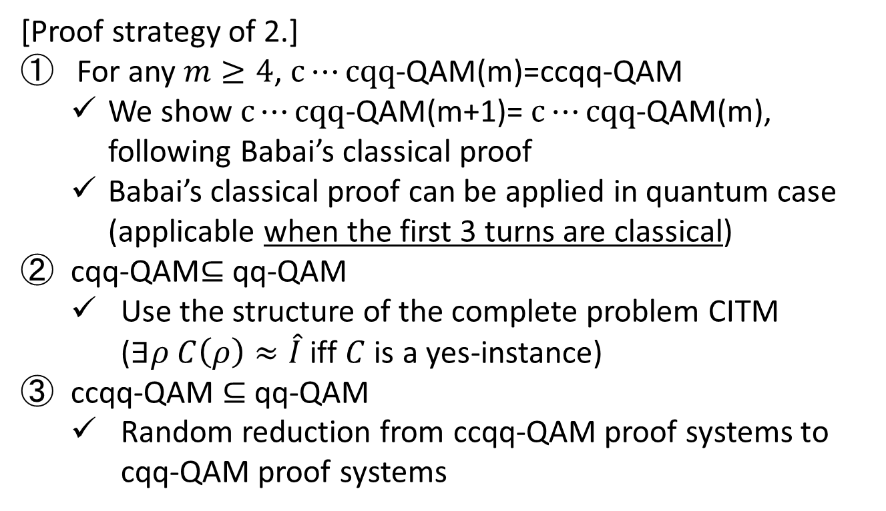
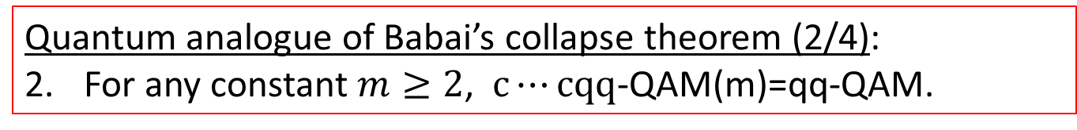
Quantum Babai’s collapse theorem
Quantum analogue of Babai’s collapse theorem (2/4):
For any constant $m≥2$, $c⋯cqq$-QAM(m)=qq-QAM.
[Proof strategy of 2.]
For any $m≥4$, $c⋯cqq$-QAM(m)=ccqq-QAM
  We show $c⋯cqq$-QAM(m+1)= $c⋯cqq$-QAM(m), following Babai’s classical proof
  Babai’s classical proof can be applied in quantum case (applicable when the first 3 turns are classical)
cqq-QAM$⊆$ qq-QAM
  Use the structure of the complete problem CITM ($∃ρ C\left(ρ\right)≈\hat{I}$ iff $C$ is a yes-instance)
ccqq-QAM $⊆$ qq-QAM
  Random reduction from ccqq-QAM proof systems to cqq-QAM proof systems

Slide 20

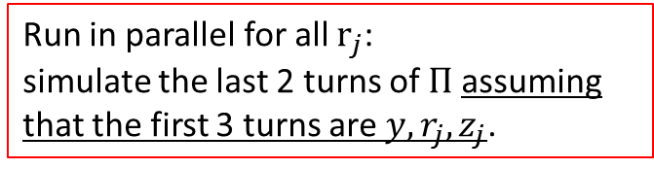






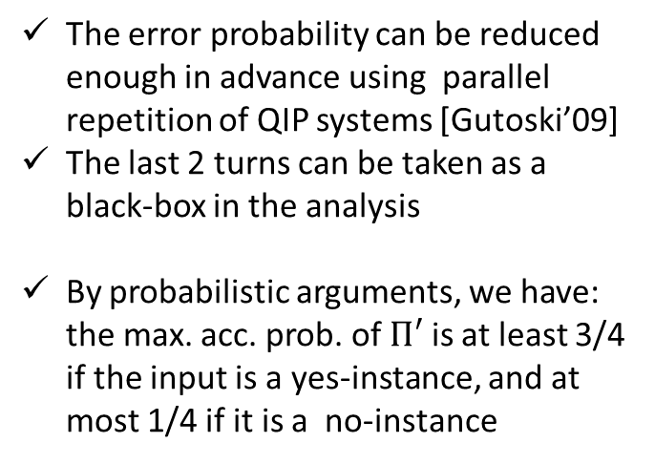


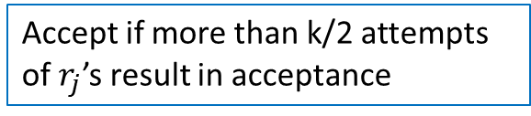
cccqq-QAM $⊆$ ccqq-QAM
cccqq-QAM proof sysytem
$$Π$$
ccqq-QAM proof sysytem
$$Π′$$
$$y$$
$$r$$
$r_{1},…,r_{k}$
$$z$$
$$y$$
$$z_{1},…,z_{k}$$
Run in parallel for all $r_{j}$:
simulate the last 2 turns of $Π$ assuming that the first 3 turns are $y, r_{j},z_{j}$.
The error probability can be reduced enough in advance using parallel repetition of QIP systems [Gutoski’09]
The last 2 turns can be taken as a black-box in the analysis
By probabilistic arguments, we have: the max. acc. prob. of $Π′$ is at least 3/4 if the input is a yes-instance, and at most 1/4 if it is a no-instance
Accept if more than k/2 attempts of $r_{j}$’s result in acceptance

Slide 21

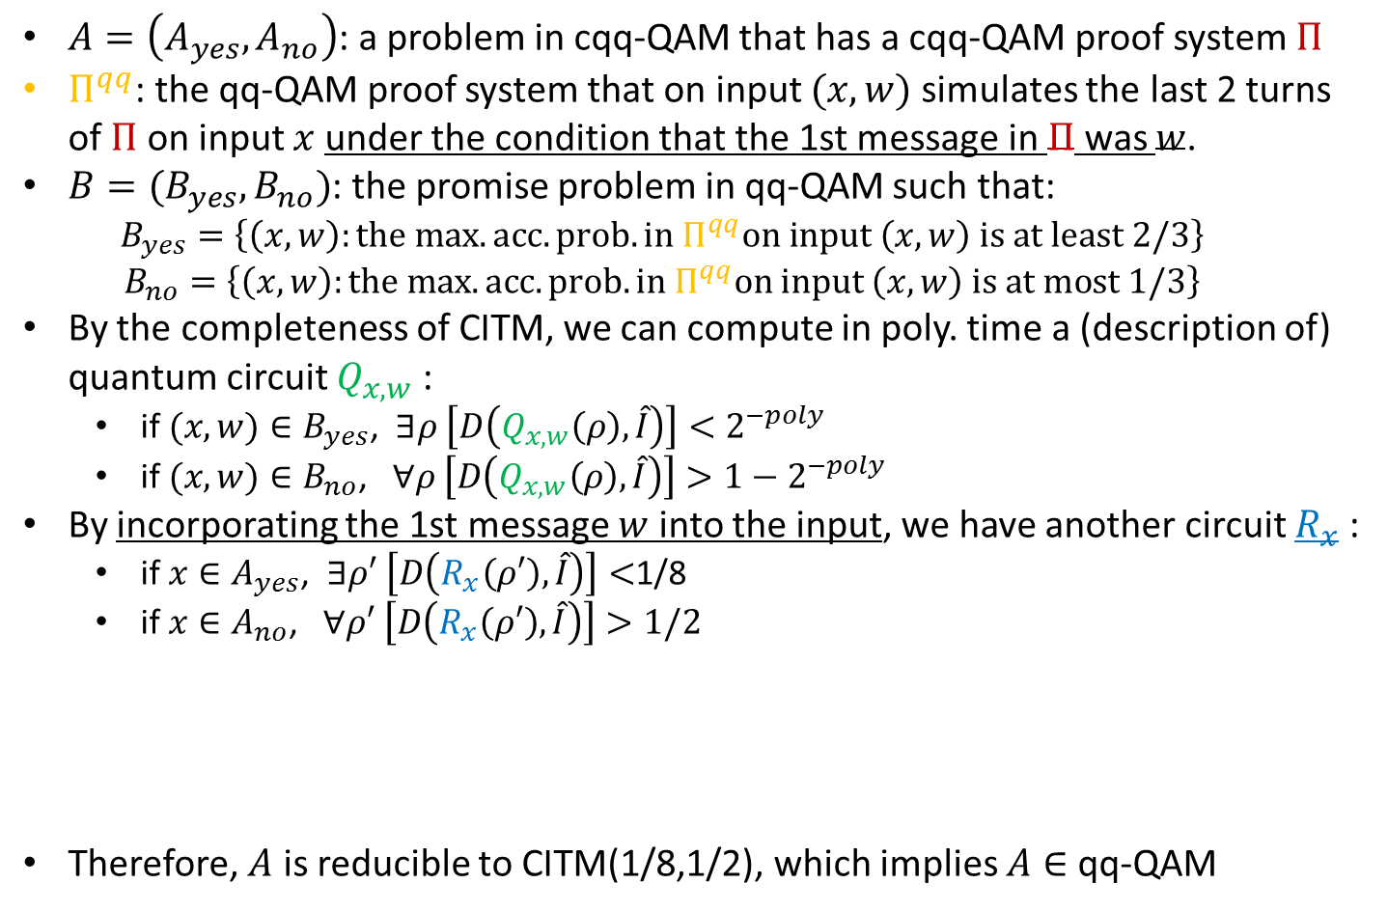


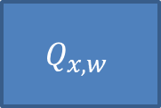

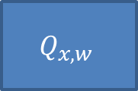

cqq-QAM $⊆$ qq-QAM
$A=\left(A_{yes},A_{no}\right)$: a problem in cqq-QAM that has a cqq-QAM proof system $Π$
$Π^{qq}$: the qq-QAM proof system that on input $(x,w)$ simulates the last 2 turns of $Π$ on input $x$ under the condition that the 1st message in $Π$ was $w$.
$B=(B_{yes},B_{no})$: the promise problem in qq-QAM such that:
  $$B_{yes}=\left\{\left(x,w\right):the max. acc. prob. in Π^{qq}on input \left(x,w\right) is at least 2/3\right\}$$
  $$B_{no}=\left\{\left(x,w\right):the max. acc. prob. in Π^{qq}on input \left(x,w\right) is at most 1/3\right\}$$
By the completeness of CITM, we can compute in poly. time a (description of) quantum circuit $Q_{x,w}$ :
  if $(x,w)∈B_{yes}$, $∃ρ \left[D\left(Q_{x,w}\left(ρ\right),\hat{I}\right)\right]<2^{−poly}$
  if $(x,w)∈B_{no}$, $∀ρ \left[D\left(Q_{x,w}\left(ρ\right),\hat{I}\right)\right]>1−2^{−poly}$
By incorporating the 1st message $w$ into the input, we have another circuit $R_{x}$ :
  if $x∈A_{yes}$, $∃ρ′ \left[D\left(R_{x}\left(ρ′\right),\hat{I}\right)\right]<$1/8
  if $x∈A_{no}$, $∀ρ′ \left[D\left(R_{x}\left(ρ′\right),\hat{I}\right)\right]>1/2$
Therefore, $A$ is reducible to CITM(1/8,1/2), which implies $A∈$ qq-QAM
In fact, we show the “qq-QAM-completeness of another problem” MaxOutEnt, which asks if the entropy of a given channel is large for any input
$$w$$
$$ρ′$$
$$ρ$$
$$Q_{x,w}$$
$$ρ$$
$$Q_{x,w}$$

Slide 22
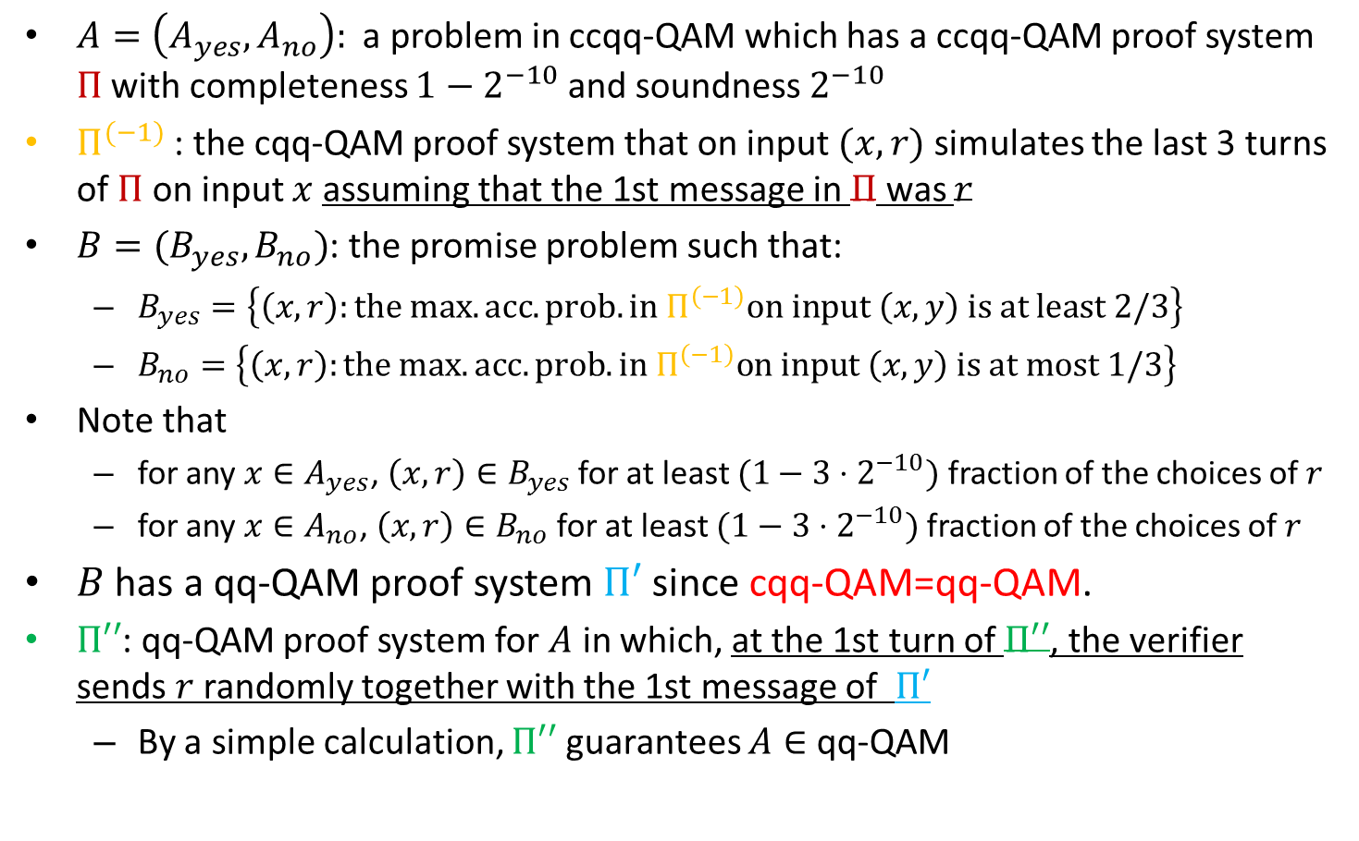

ccqq-QAM $⊆$ qq-QAM
$A=\left(A_{yes},A_{no}\right):$ a problem in ccqq-QAM which has a ccqq-QAM proof system $Π$ with completeness $1−2^{−10}$ and soundness $2^{−10}$
$Π^{(−1)}$: the cqq-QAM proof system that on input $(x,r)$ simulates the last 3 turns of $Π$ on input $x$ assuming that the 1st message in $Π$ was $r$
$B=(B_{yes},B_{no})$: the promise problem such that:
  $B_{yes}=\left\{\left(x,r\right):the max. acc. prob. in Π^{\left(−1\right)}on input \left(x,y\right) is at least 2/3\right\}$
  $B_{no}=\left\{\left(x,r\right):the max. acc. prob. in Π^{\left(−1\right)}on input \left(x,y\right) is at most 1/3\right\}$
Note that
  for any $x∈A_{yes}$, $\left(x,r\right)∈B_{yes}$ for at least $(1−3⋅2^{−10})$ fraction of the choices of $r$
  for any $x∈A_{no}$, $\left(x,r\right)∈B_{no}$ for at least $(1−3⋅2^{−10})$ fraction of the choices of $r$
$B$ has a qq-QAM proof system $Π′$ since cqq-QAM=qq-QAM.
$Π′′$: qq-QAM proof system for $A$ in which, at the 1st turn of $Π′′$, the verifier sends $r$ randomly together with the 1st message of $Π′$
  By a simple calculation, $Π′′$ guarantees $A∈$ qq-QAM

Slide 23
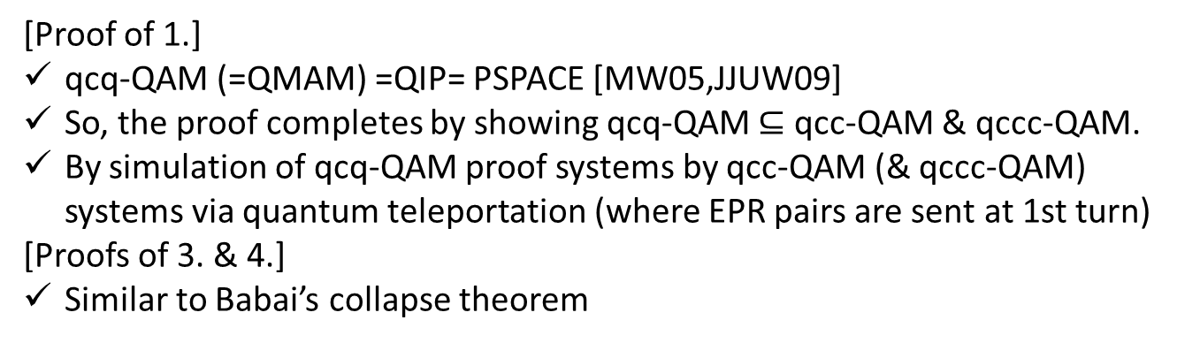
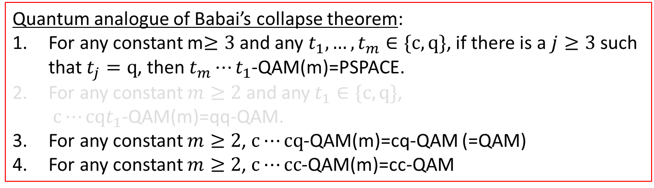
Quantum Babai’s collapse theorem
Quantum analogue of Babai’s collapse theorem:
For any constant m$≥3$ and any $t_{1},…,t_{m}∈\{c,q\}$, if there is a $j≥3$ such that $t_{j}=q$, then $t_{m}⋯t_{1}$-QAM(m)=PSPACE.
For any constant $m≥2$ and any $t_{1}∈\{c,q\}$, $c⋯cqt_{1}$-QAM(m)=qq-QAM.
For any constant $m≥2$, $c⋯cq$-QAM(m)=cq-QAM (=QAM)
For any constant $m≥2$, $c⋯cc$-QAM(m)=cc-QAM
[Proof of 1.]
qcq-QAM (=QMAM) =QIP= PSPACE [MW05,JJUW09]
So, the proof completes by showing qcq-QAM $⊆$ qcc-QAM & qccc-QAM.
By simulation of qcq-QAM proof systems by qcc-QAM (& qccc-QAM) systems via quantum teleportation (where EPR pairs are sent at 1st turn)
[Proofs of 3. & 4.]
Similar to Babai’s collapse theorem

Slide 24
Summary & Future Work

Slide 25
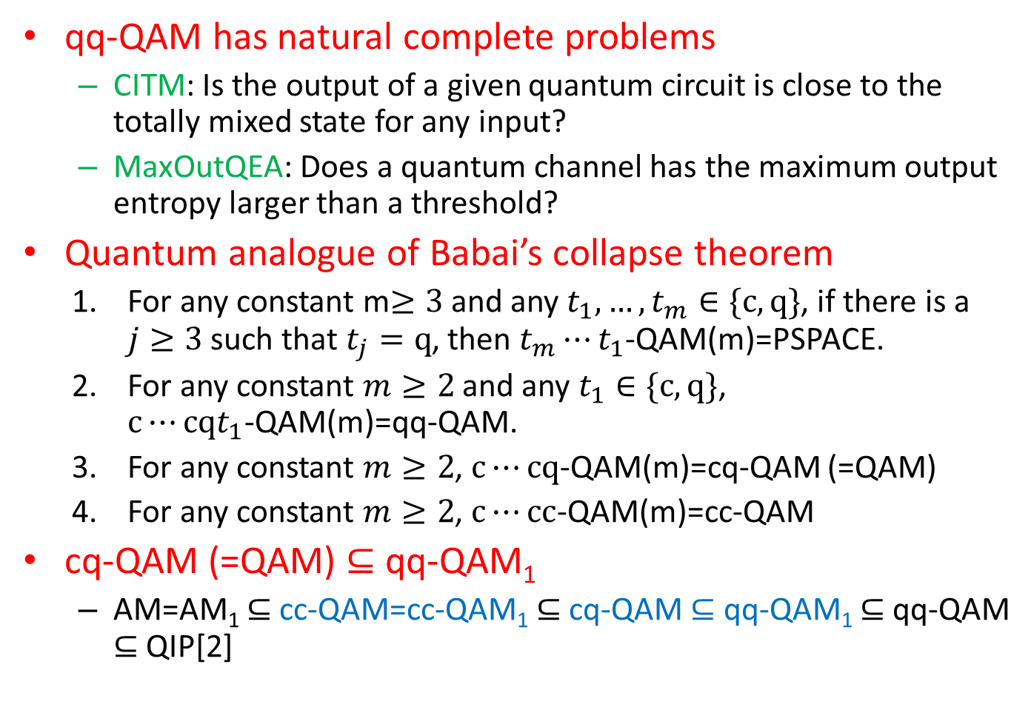
Summary
qq-QAM has natural complete problems
  CITM: Is the output of a given quantum circuit is close to the totally mixed state for any input?
  MaxOutQEA: Does a quantum channel has the maximum output entropy larger than a threshold?
Quantum analogue of Babai’s collapse theorem
  For any constant m$≥3$ and any $t_{1},…,t_{m}∈\{c,q\}$, if there is a $j≥3$ such that $t_{j}=q$, then $t_{m}⋯t_{1}$-QAM(m)=PSPACE.
  For any constant $m≥2$ and any $t_{1}∈\{c,q\}$, $c⋯cqt_{1}$-QAM(m)=qq-QAM.
  For any constant $m≥2$, $c⋯cq$-QAM(m)=cq-QAM (=QAM)
  For any constant $m≥2$, $c⋯cc$-QAM(m)=cc-QAM
cq-QAM (=QAM) $⊆$ qq-QAM₁
  AM=AM₁ $⊆$ cc-QAM=cc-QAM₁ $⊆$ cq-QAM $⊆$ qq-QAM₁ $⊆$ qq-QAM $⊆$ QIP[2]

Slide 26
Open Problems
Find any natural problem in qq-QAM that is not known to be in cq-QAM.
  Or qq-QAM=cq-QAM?
Non-trivial lower bound and upper bound for qq-QAM
  lower bound: cq-QAM; upper bound: QIP[2]
  Is QSZK contained in qq-QAM? (cf. SZK⊆AM)
qq-QAM=qq-QAM₁?
  similar questions remain open for cq-QAM and QIP[2]
Quantum analogue for the Goldwasser-Sipser theorem
  What if classical interaction is added before QIP(2) proof systems?
Thank you

